Slide 1
For our God is a consuming fire. (Heb 12:29)

Slide 2
At the close of the thousand years, Christ again returns to the earth. He is accompanied by the host of the redeemed and attended by a retinue of angels. As He descends in terrific majesty He bids the wicked dead arise to receive their doom. They come forth, a mighty host, numberless as the sands of the sea. What a contrast to those who were raised at the first resurrection! The righteous were clothed with immortal youth and beauty. The wicked bear the traces of disease and death. { GC 662.1}

Slide 3
For I,’ says the Lord, ‘will be a wall of fire all around her, and I will be the glory in her midst.’ ” (Zec 2:5 KJV)

Slide 4
And the LORD will create upon every dwelling place of mount Zion, and upon her assemblies, a cloud and smoke by day, and the shining of a flaming fire by night: for upon all the glory shall be a defence. (Isa 4:5 KJV)
“And Jehovah creates over every spot of Mount Zion, and over its festal assemblies, a cloud by day, and smoke, and the shining of flaming fire by night: for over all the glory comes a canopy.”
Isaiah 4:5 (Keil & Delitzch)

Slide 5
There shall be no more thence an infant of days, nor an old man that hath not filled his days: for the child shall die an hundred years old; but the sinner being an hundred years old shall be accursed. (Isa 65:20 KJV)
“And there shall no more come thence a suckling of a few days, and an old man who has not lived out all his days; for the youth in it will die as one a hundred years old, and the sinner be smitten with the curse as one a hundred years old.” Isaiah 65:20 (Keil & Delitzch)

Slide 6
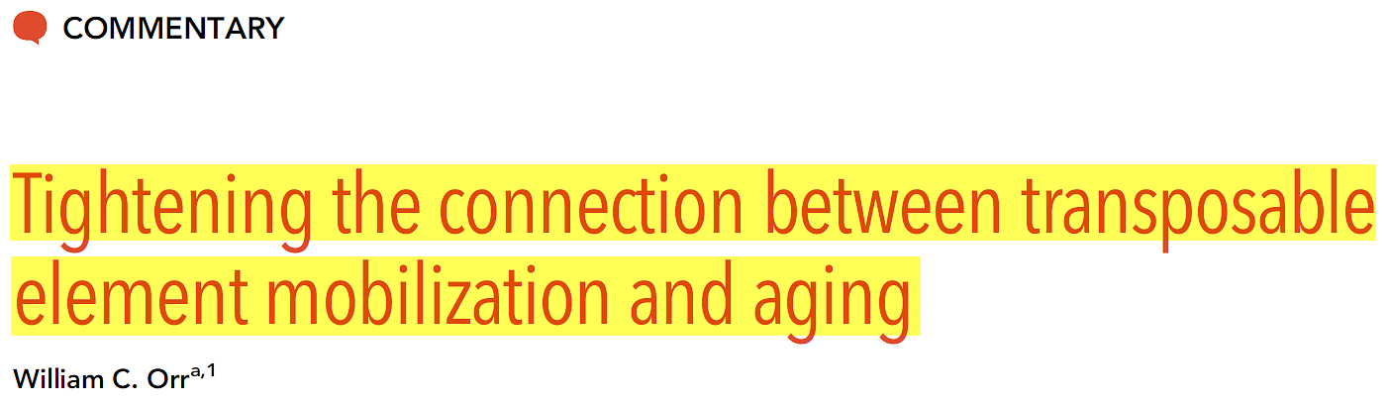
Studies in organisms as diverse as yeast, worms, flies, mice, and human cell culture have documented a decline in repressive heterochromatin with senescence, and genetic interventions have indicated that maintaining repressive heterochromatin might be beneficial for increasing healthy life span.
PNAS | October 4, 2016 | vol. 113 | no. 40 | 11069–11070

Slide 7
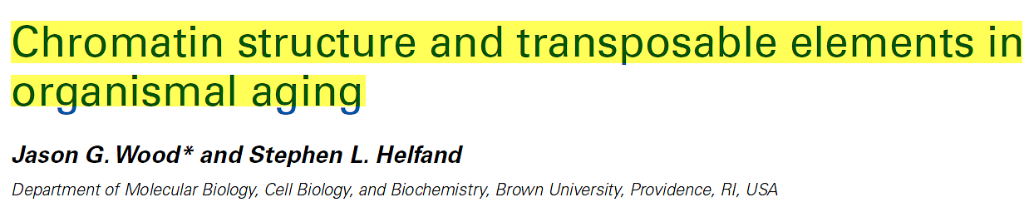
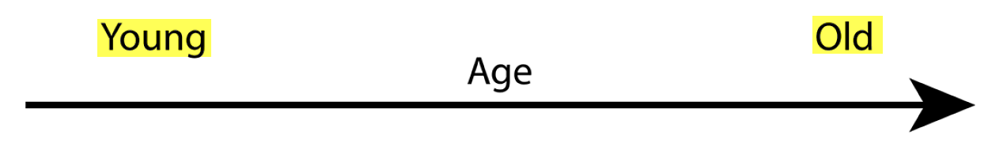
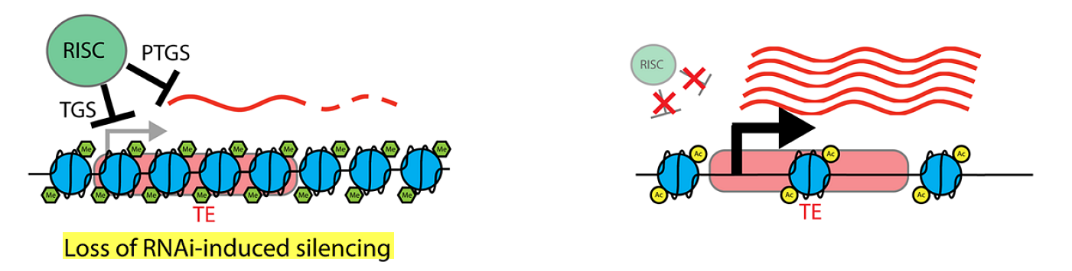
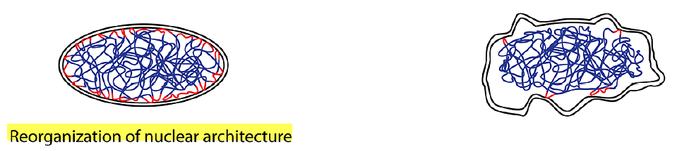
Loss of PTGS can lead to increased levels of TE transcripts, which can undergo transposition and land in other areas of the genome, with deleterious effects.
The RNAi-induced silencing complex (RISC).
Transcriptional gene silencing- (TGS)
Post transcriptional gene silencing (PTGS)
Heterochromatic LADs (lamin-associated domains) are marked in red, where they associate with the nuclear lamina on the inner nuclear membrane.
Humans born with defective lamins have what disease?
Frontiers in Genetics. December 2013 | Volume4 | Article 274

Slide 8
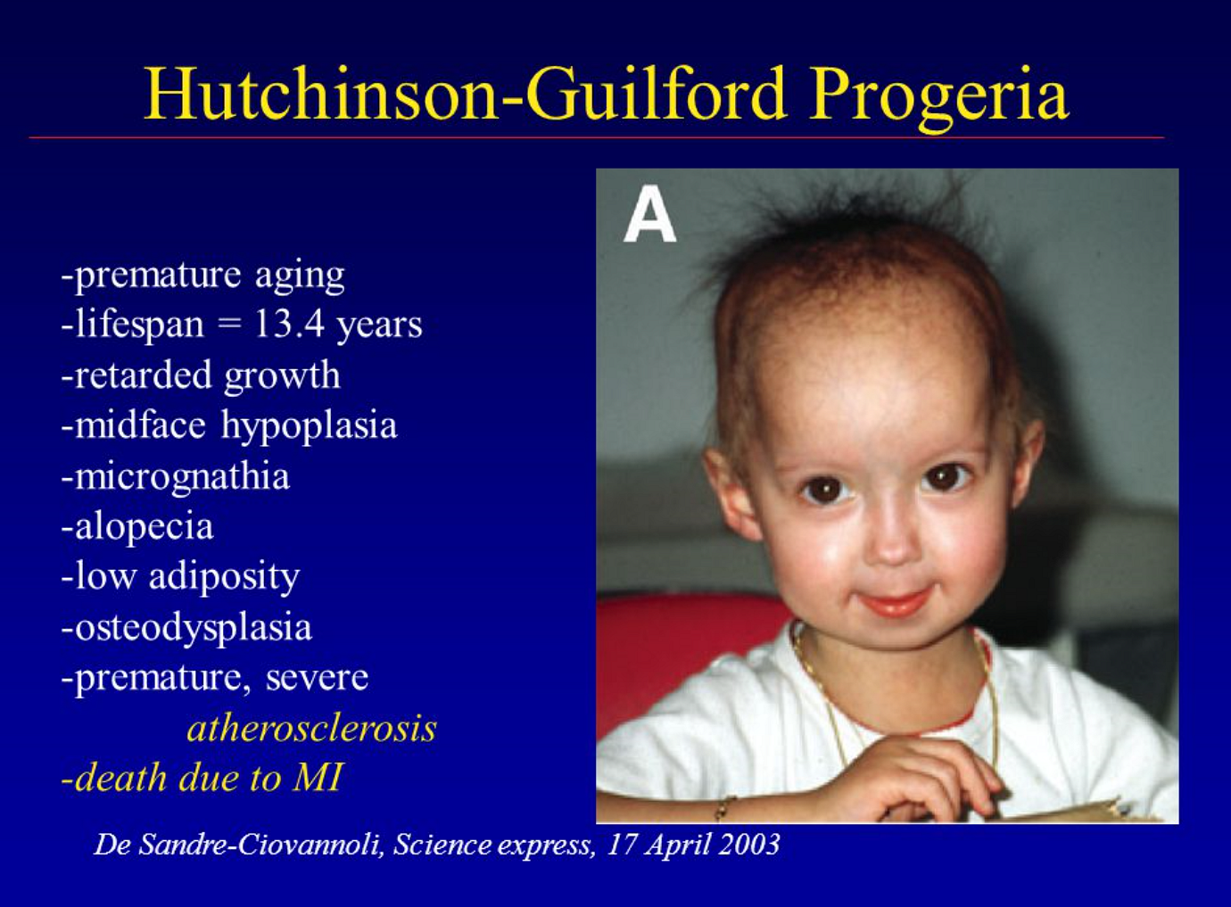

Slide 9
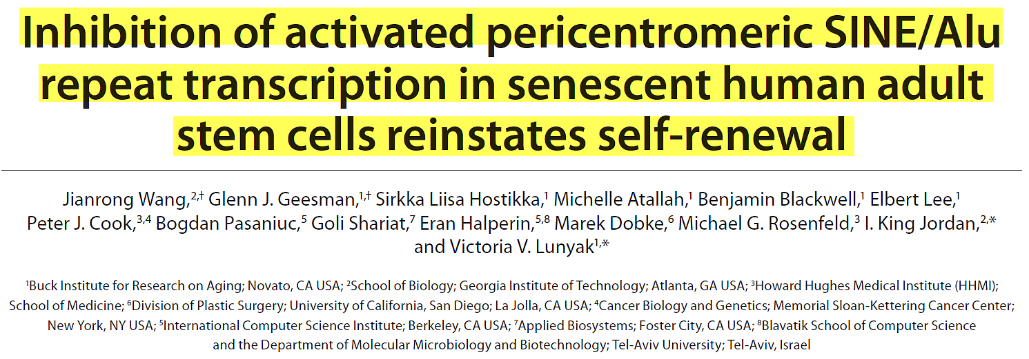
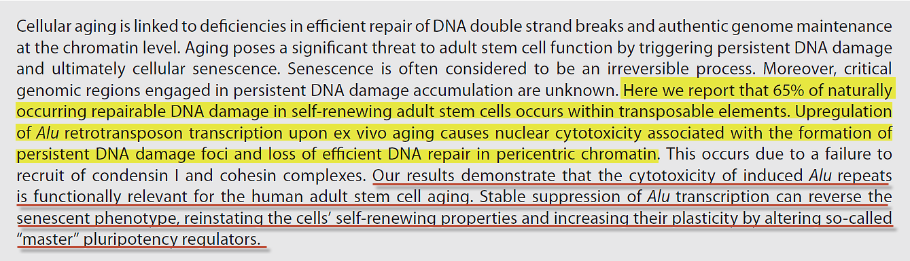
Cell Cycle 10:17, 3016-3030; September 1, 2011

